Slide 1

Entertainer Data Analysis

Slide 2
Introduction
In the entertainment industry, understanding audience preferences, trends, and performance metrics is crucial for making informed decisions. This analysis focuses on the data related to entertainers, such as musicians, actors, and performers, to derive insights that can help in strategic planning, marketing, and improving audience engagement.

Slide 3
Details of Data
The data in the image appears to be a table containing information about various entertainers. Here is a breakdown of the columns and the data they contain:
Columns:-
Entertainer: The name of the entertainer.
Gender (traditional): Gender of the entertainer.
Birth Year: The year the entertainer was born.
Year of Breakthrough/#1 Hit/Award Nomination: The year the entertainer had their breakthrough or first major hit/award nomination.
Breakthrough Name: The name of the work that led to their breakthrough.
Year of First Oscar/Grammy/Emmy: The year they won their first major award.
Year of Last Major Work (arguable): The year they had their last major work.
Year of Death: The year the entertainer passed away (if applicable).
Award Won from Breakthrough: The award won for their breakthrough work.
Total Awards Won: The total number of awards the entertainer has won.
Total Nominees: The total number of nominations the entertainer has received.
Profession: The profession of the entertainer (e.g., Singer, Actor).
Oscar Won: The number of Oscars won by the entertainer.
Grammy Won: The number of Grammys won by the entertainer.
Emmy Won: The number of Emmys won by the entertainer.
Other Awards: The number of other awards won by the entertainer.

Slide 4
Main KPIs
Number of Major Awards Won
Number of Nominations
Career Longevity and Activity
Significant Career Events
Demographic Information
Profession

Slide 5
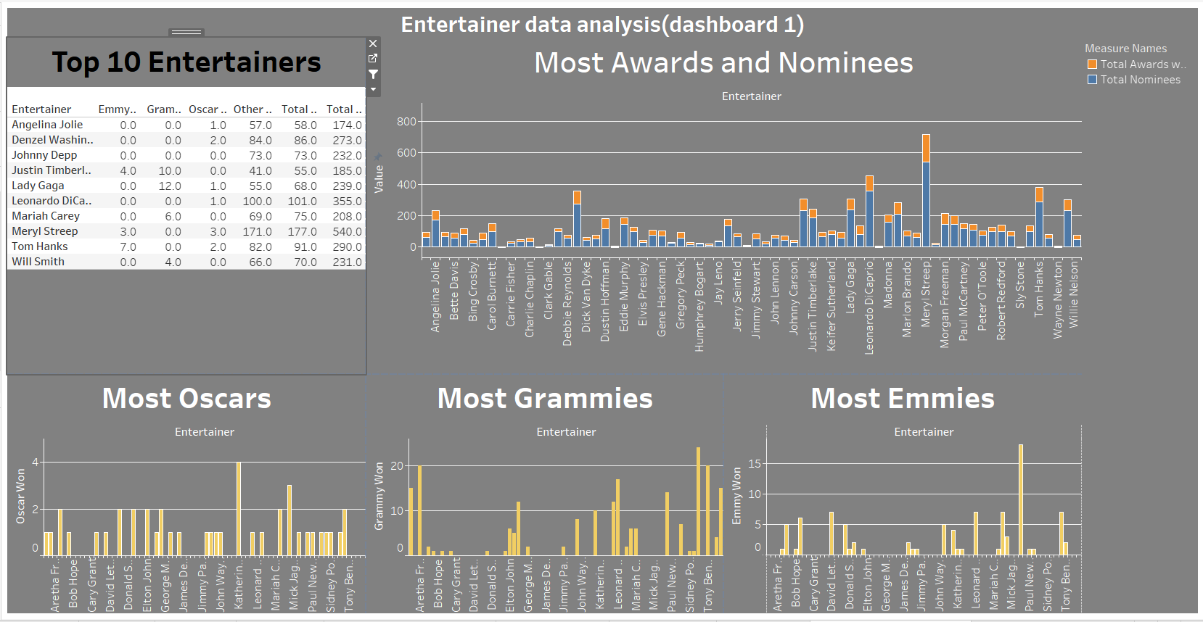
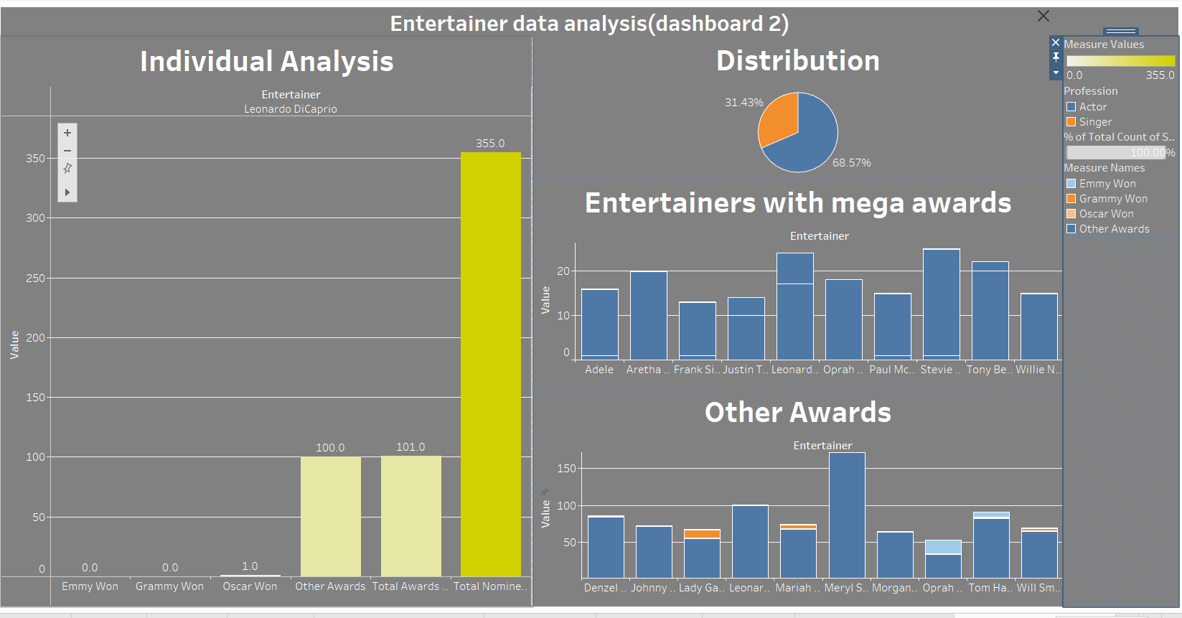
My Design

Slide 6
Thank you

